Slide 1
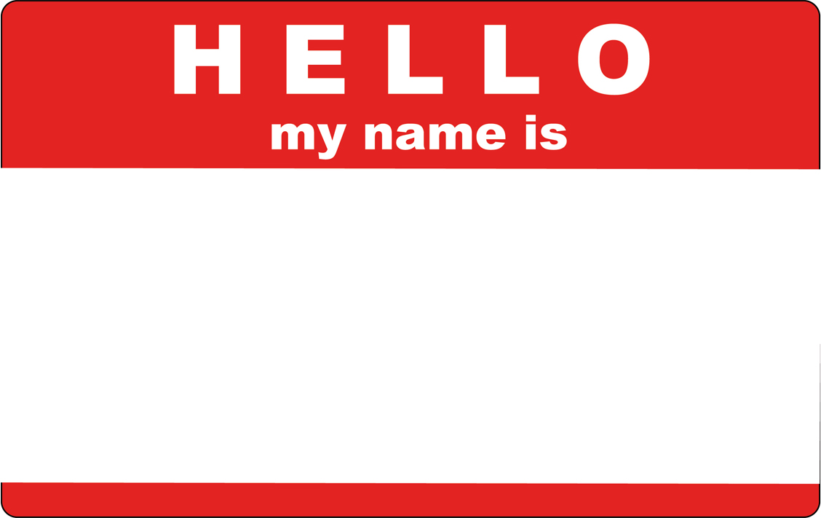
Dan
MacLean
Notes:
I like to introduce myself
My name is Dan

Slide 2
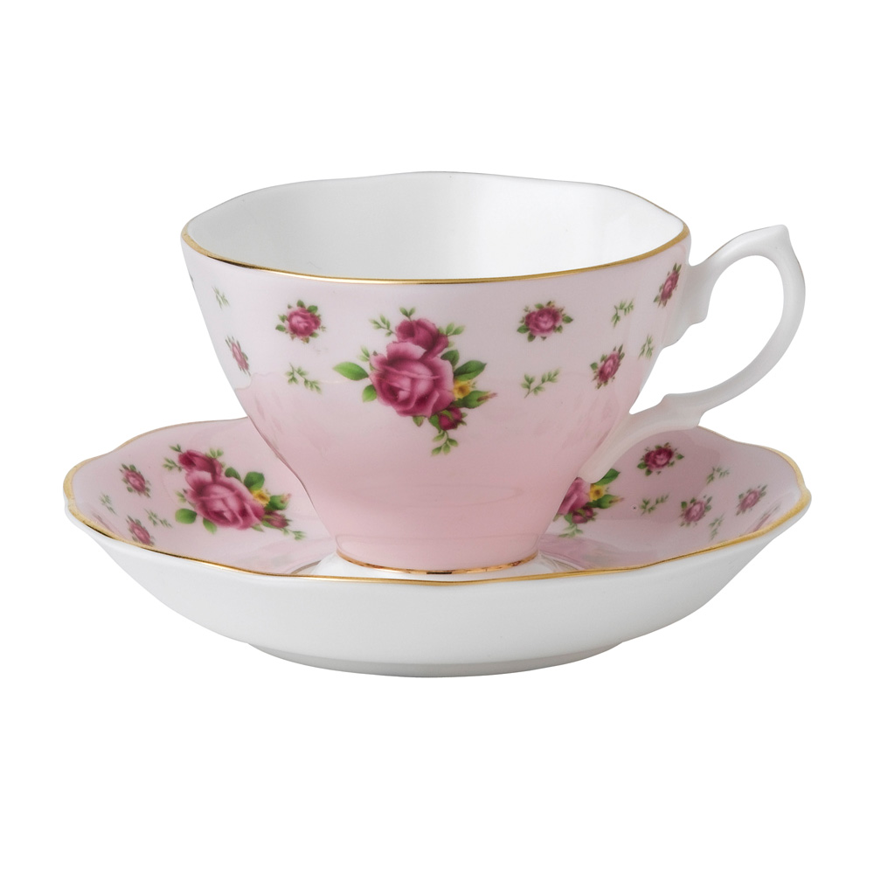
Notes:
And Im from England

Slide 3

Notes:
But Im not this sort of Englishman, Im not the stereotypical sort

Slide 4
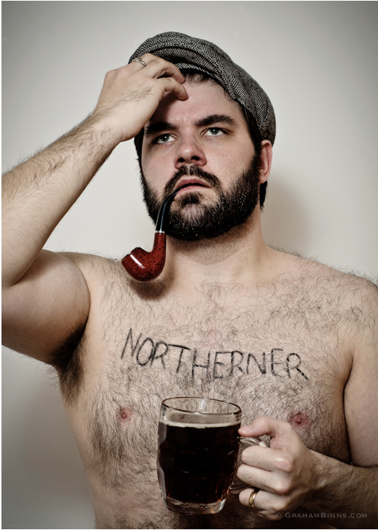
Notes:
Im much more this sort of englishman. Im from the North of England, Im from Manchester, in fact. And we aren’t the stereotypical sort of Brit.

Slide 5
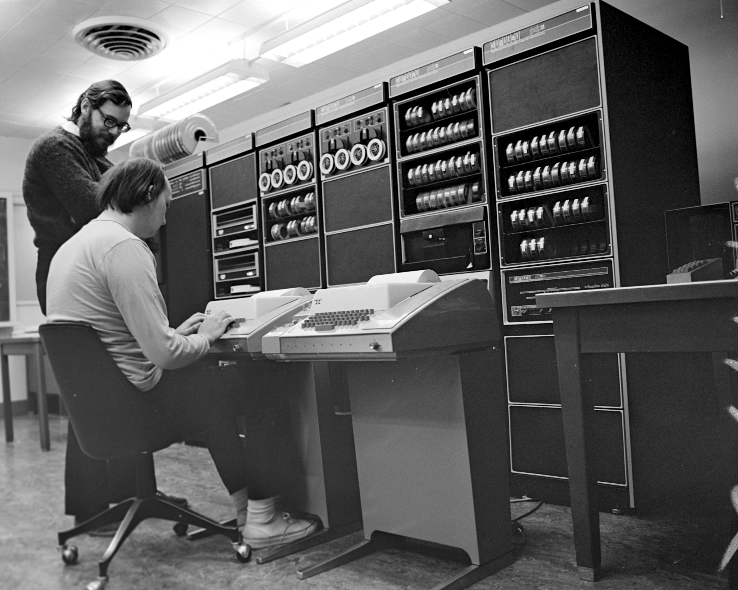
Notes:
Im also a bioinformatician which means Im a biologist with super powers.

Slide 6

Notes:
I work at the Sainsbury Lab, which is in Norwich in the East of England, and we study plant microbe interactions. In particular pathogen interactions. And we work on basic and translational research in this field.

Slide 7
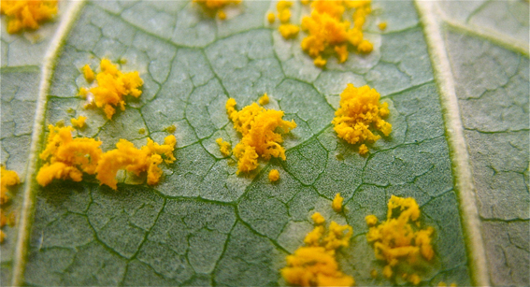
From the ground up
New genomics tools for small communities working with emergent pathogens and non-models
@danmaclean
dan.maclean@tsl.ac.uk
http://danmaclean.info
Notes:
MY groups research focus is to bridge the technology and knowledge gap between big industrial level science like genomics and the labs where the expertise is concentrated. We want to help put the bio back in bioinformatics.

Slide 8
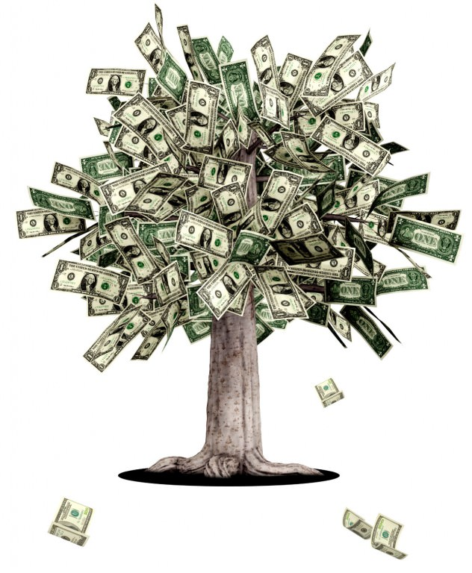
How do you start a genomics project quickly or without a great big grant?
Notes:
So the first big question we’re looking at in our group – How do you kick off a new project without front loaded funding – How do you get the genomics resource for a brand new pathogen no-one has any knowledge about?

Slide 9






Notes:
One way is to take a cue from the open source software world and ideas from open access databases.
This is a world where every piece of information remains available to anyone at any time, and the people contributing or using feel an intrinsic value in contributing to the over-all goals of the project.
And this isn’t a model we really have in science - normally we have to wait for funding of relatively isolated groups on specific projects and then,
because we are relying on high profile publications to get further funding we sit on results which makes the cycle worse.
and release data only when we’ve finished our own analyses and are ready to publish.
We can kickstart knowledge by making whatever data we can generate and can find instantly available, even before it is analysed, and let whoever can help, do what they can
The practical upshot of this is valuable data gets to many more people who can deal with it much more quickly and more is learned quickly.
We got a great chance to apply this sharing principle for emergent pathogens a couple of years ago

Slide 10
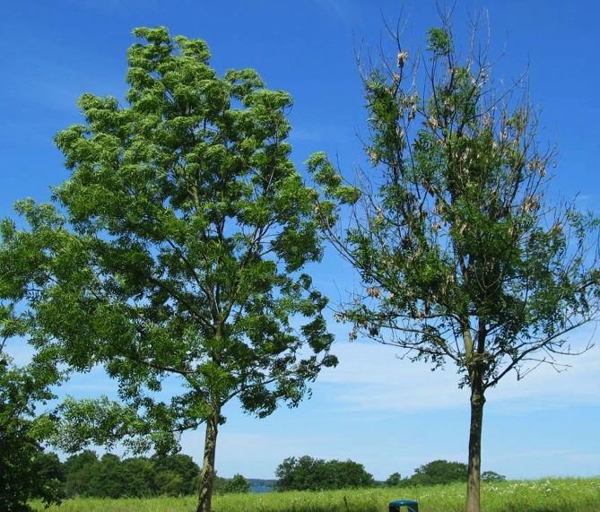
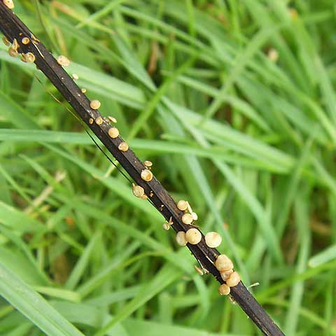
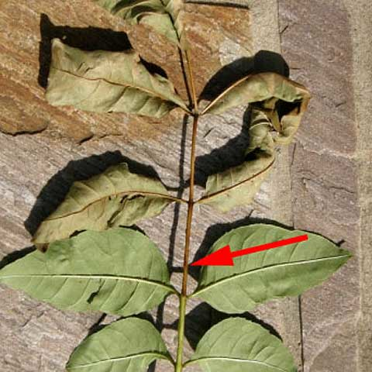
Ash / Fresno (Fraxinus excelsior)
Notes:
… when the ash dieback pathogen reached the uk.
Ash, or Fraxinus excelsior, is an important tree and has been so throughout history.
Ecologically Ash is vital, it’s a fast growing tree that crops up quickly in gaps in woodland and can support a massive range of biodiversity
This is what ash dieback looks like
Two roadside trees, the right tree is now severely affected and the disease is even starting to affect the growth and the size of it’s crown.
Ash dieback is clearly noticeable as lesions and cankers on stems and branches. Throughout summer you can also see leaves with brown leaf stalks.
Its arrival in England in 2012 caused a fuss in the media and we realised we needed a way to respond quickly and kickstart the research.

Slide 11
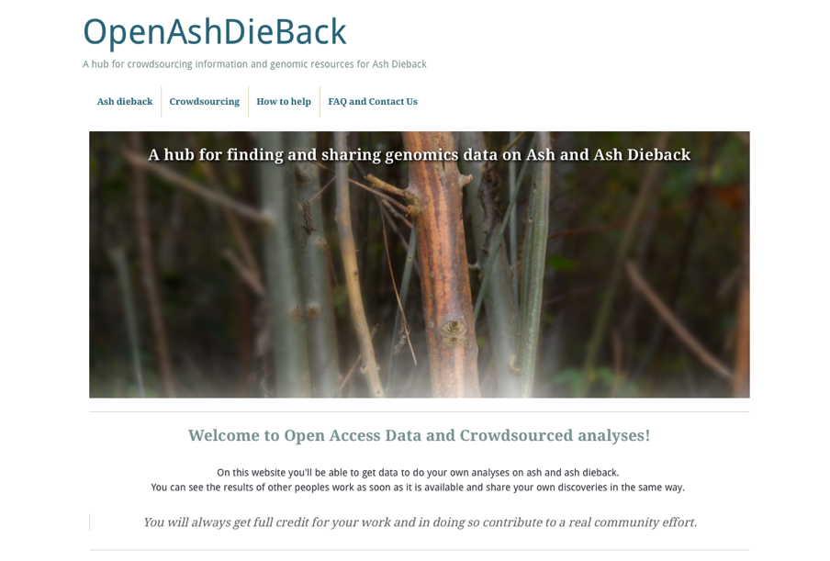
http://oadb.tsl.ac.uk
Notes:
So we applied Open Source and Open Access data principles to try and fast-forward collaboration on genomics of ash and ash dieback.
We’ve put up a hub website to facilitate this, called OpenAshDieBack. Which is at this URL. This website contains links to our data repo and blog posts describing the analyses and data that people have contributed

Slide 12



ATTRIBUTION OF CONTRIBUTION
Git and GitHub as a versioned database
push
back
pull
data
make change
Notes:
The data and results themselves are actually hosted externally on the public website, github.
If you’re not familiar with github, it’s a peculiar sort of social networking site
Github is a programmers social coding website. Github is really great at tracking changes to files and keeping records of who made these changes.
The work cycle is really straightforward: you start the day by pulling the latest version of the data from github,
you make the changes/additions/new data that you think are appropriate and push it back.
Github sits in the middle keeping track of what changes were made and who made them.
That’s the key reason for using github, because its critical that we make proper attribution of contribution.
If we’re going to get people to give their time and effort for free, we really need to make sure that we’re giving credit for it.

Slide 13
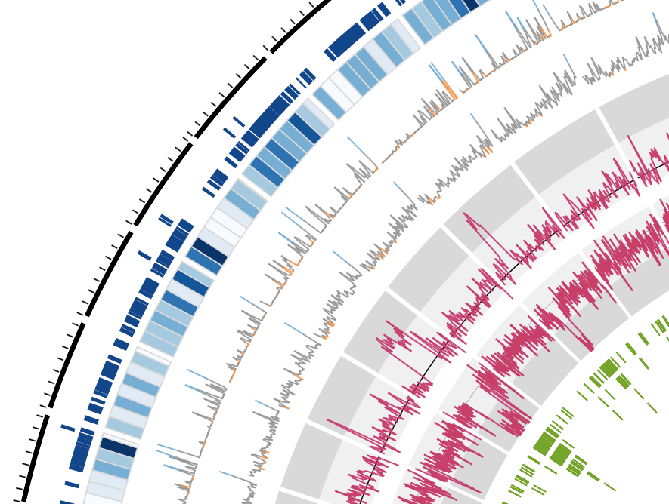
CROWDSOURCING GETS RESULTS
A repeat-rich genome
http://dx.doi.org/10.6084/m9.figshare.791640
Notes:
The analyses are going well,
We’ve been able to push quite far through crowdsourcing analyses and are starting to build up quite a good story about our pathogen.
We had a lot of sequence data provided, of great use was some early RNAseq interaction transcriptomes sampled directly from the tree that identified potential mating loci and types. These were generated by keen workers in The Sainsbury Lab.
TGAC in Norwich provided us with DNA sequence and a first draft assembly and annotations.

Slide 14
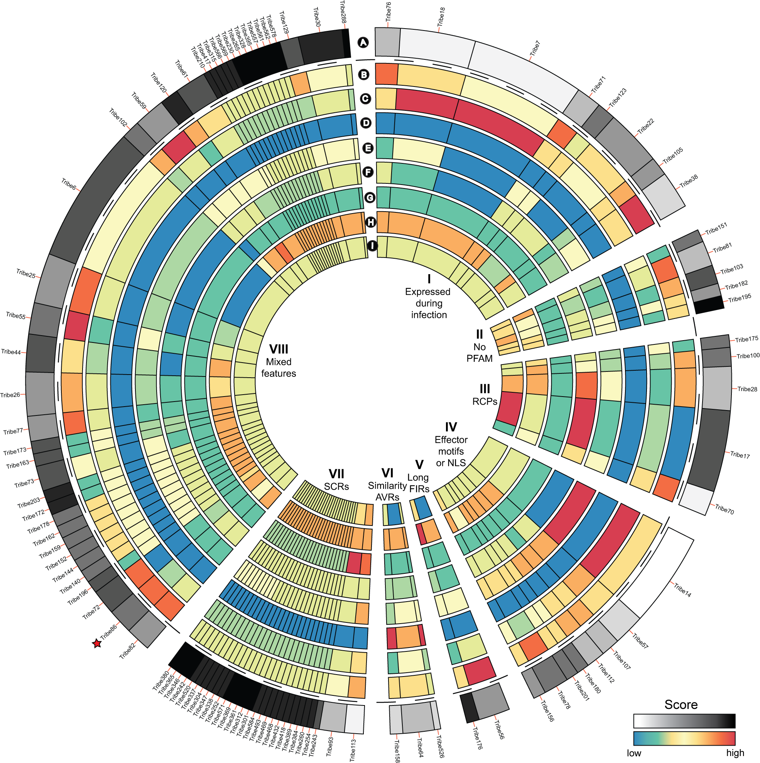
Identifying effector candidates
Diane Saunders
- JIC
http://dx.doi.org/10.6084/m9.figshare.1005005
Notes:
Diane Saunders predicted proteome of ash dieback KW1 for potential secreted proteins
She then clustered all proteins based on sequence similarity using OrthoMCL to create these tribes, the groups you see in the diagram, we annotated the protein tribes for known effector features
WE see a few common groups like those expressed during infection, those with common effector motifs, etc. And with this we identified a repertoire of effector candidates.

Slide 15
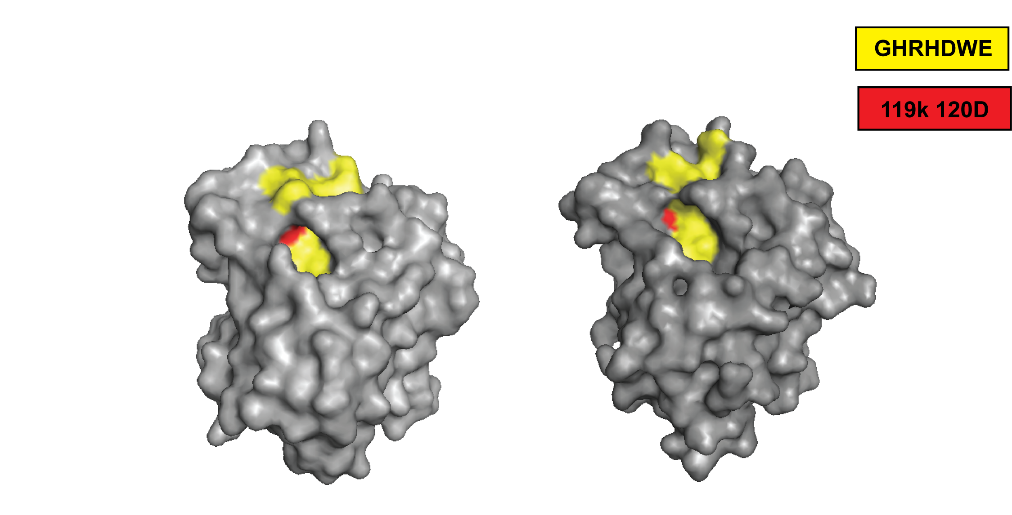
TOXINS ENCODED
Nep1-like protein in the genome
Suomeng Dong
H.pseudoalbidus hypothetical NLP
NLPpya 3GNU
http://dx.doi.org/10.6084/m9.figshare.1005010
Notes:
Suomeng Dong collated seven fungal and oomycete Nep1-like protein (NLP) sequences from public databases and used these in a tblastn against the h.pseu transcript assemblies. He identified a transcript with high similarity to NLPs,
The protein sequence was then used for protein structure modelling, with the published NLPpya 3GNU as a template. This analysis shows that the predicted protein we identified carries all the key residues for NLP cytolytic function, these red ones here.

Slide 16
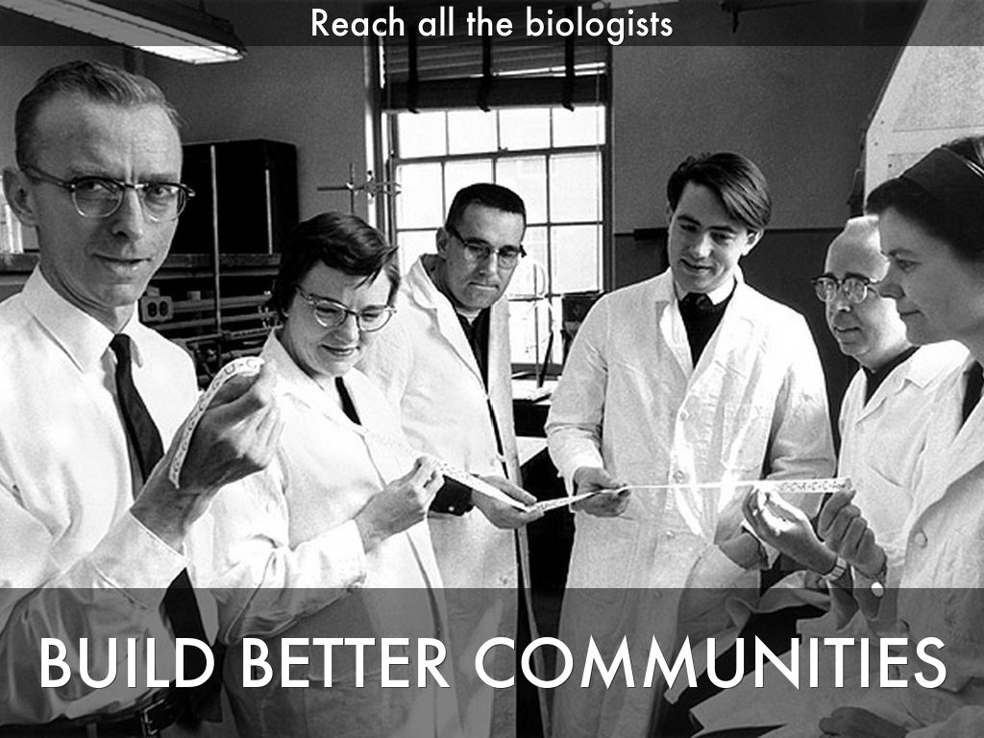
Photo by mars_discovery_district - Creative Commons Attribution-NonCommercial-ShareAlike License http://www.flickr.com/photos/17016583@N00
Created with Haiku Deck
Notes:
We realised that to really add value to our data then the important thing is to bring in as many biologists and not just genomicists, to get involved and liberate the genomics data and expertise to them and get the insights back from them.

Slide 17
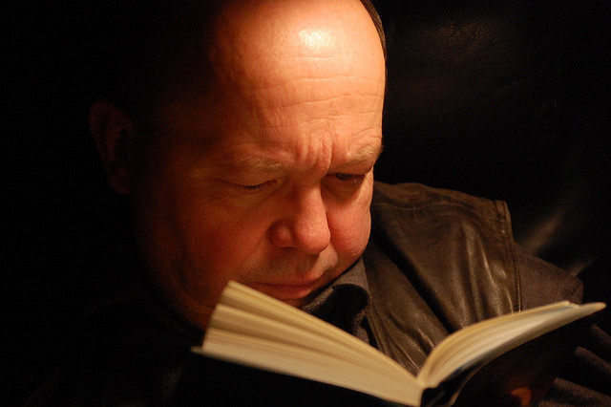
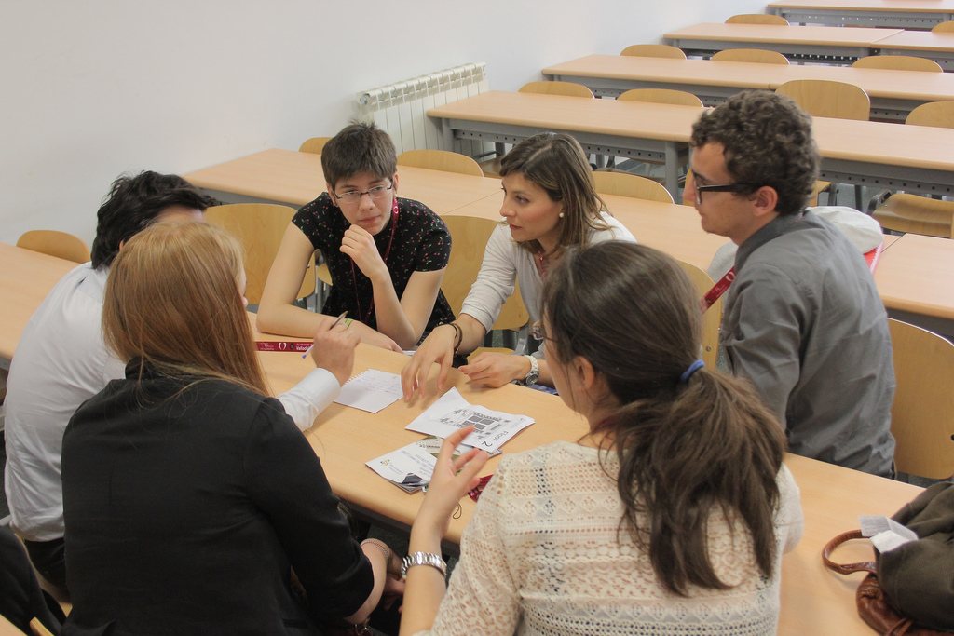
Genomics – a group activity
Reading by JanH on flickr, licensed under CC-BY-NC-SA 2.0
Discussion by Bestorg on flickr, licensed under CC-BY-NC 2.0
Notes:
And we’re trying this through new tools and interfaces.
We’ve put together something we’re calling a crowdsourcing genome-browser. Im sure that you’re familiar with the idea of a genome browser.
Our crowdsourcing browser relates to that in the same way that this guy reading his book relates to these people having a discussion. Our new crowdsourcing browser allows us to take in things like annotations, and experimental information straight into the repository. The info is recorded piecemeal and reflected back to the other users of the tool directly.

Slide 18
GeeFu
Open Source Distributed Genome Annotator and Browser
Notes:
The tool is called GeeFu and it is a graphical tool available over the web, you can annotate and edit genes and transcripts and whole genomes just by clicking and typing.

Slide 19

GeeFu
Open Source Distributed Genome Annotator and Browser
Feature Editor
You have earned the ‘Feature Editor’ badge, Click here to collect it
Notes:
GeeFu can also be set up to dispense rewards for doing work. Completing different numbers of tasks awards the user a badge that can be used to show their expertise. This is particularly helpful for junior researchers and encourages them to add a little knowledge at a time and gain something that differentiates their CVs from others.

Slide 20
GeeFu – in browser analysis
Notes:
GeeFu also provides analysis tools like sequence searches of the provided data too, and fully cross links this back to the annotations and reports Kind of like a “build your own NCBI”, but restricted to a new and growing set of information for the new organism

Slide 21

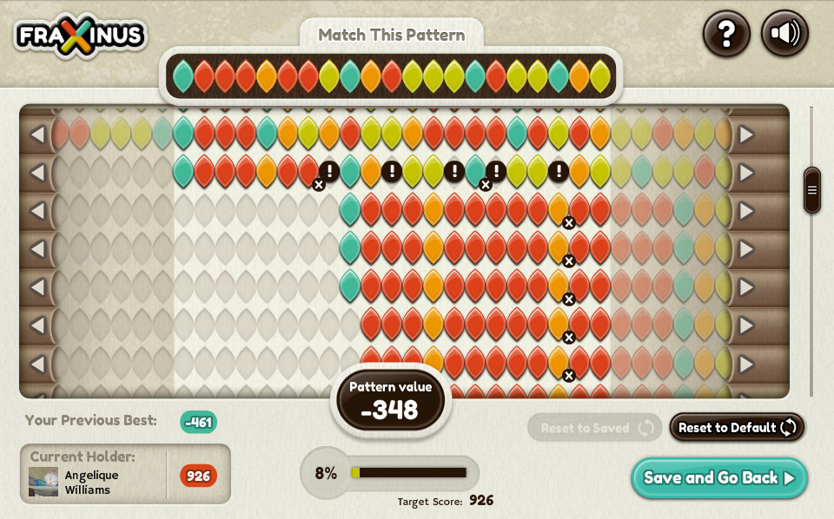

Citizen Science
Notes:
We went one step further than that though and crowd sourced from the general public.
We produced a Facebook game called Fraxinus that presents tricky multiple sequence alignment puzzles from our ash dieback data to a player and they can manually sort them out for us.
This is the game screen of Fraxinus, Along the top we have Target Pattern, from one of our references.
The rest of the coloured rows are reads from DNA sequencing experiments. The player can manually alter the reads to make the best alignments
Once player has maximum score they think they can get, they can claim the pattern for themselves and get points for that, and it all goes back into our databases for further use. The players did really well, outperforming the high throughput algorithms in variants like indels.

Slide 22
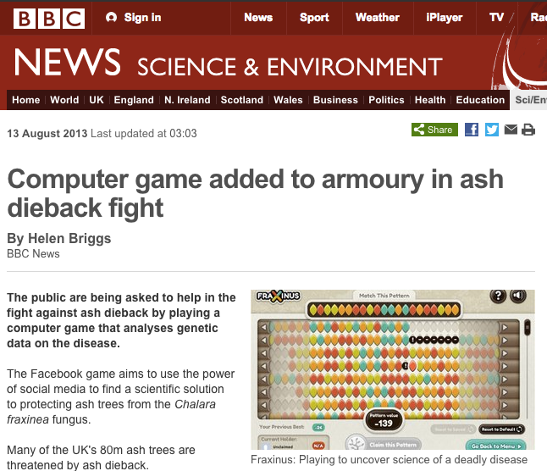
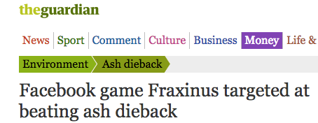
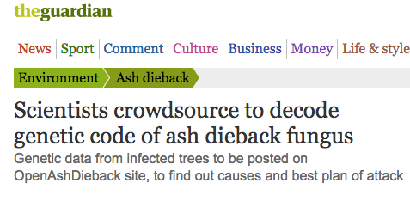
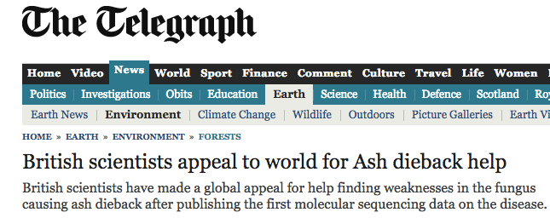
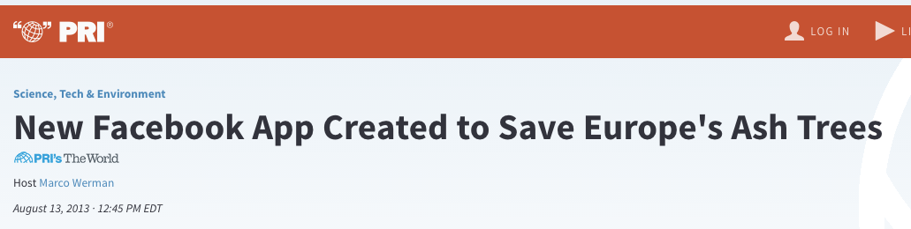
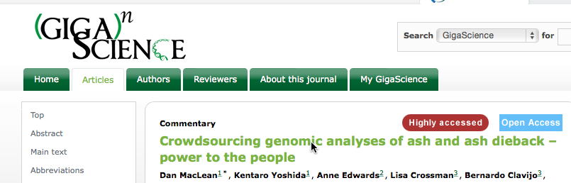
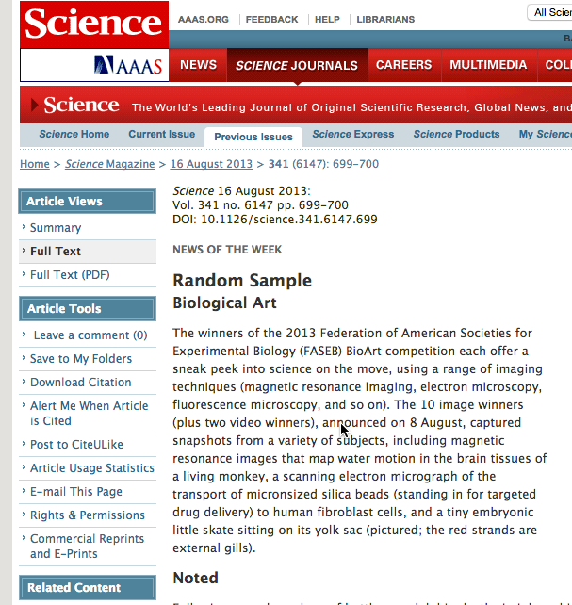
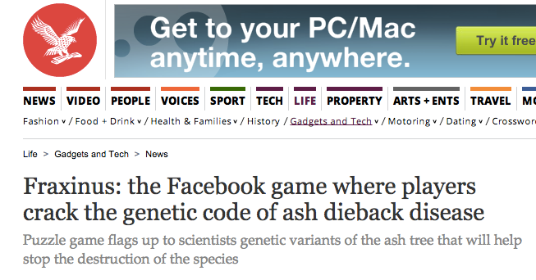
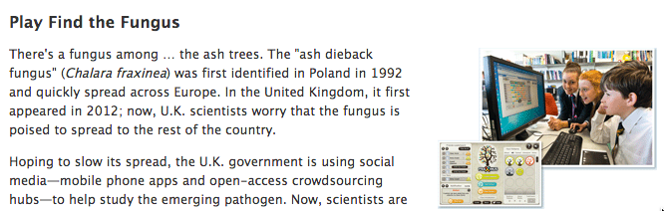
Global Impact Genomics
Notes:
And this approach had a strong impact, it was picked up by a wide range of news and media outlets across the world and proved to be very popular.

Slide 23
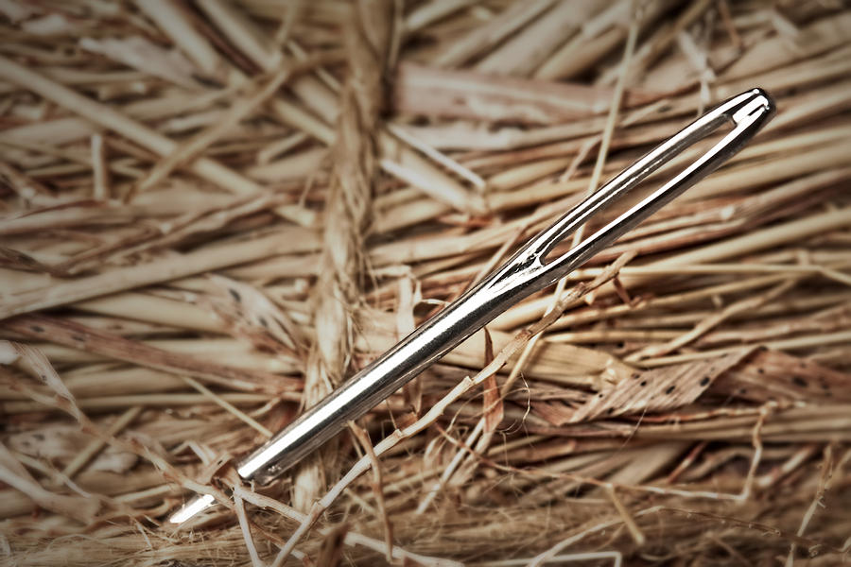
How do you identify causative mutations without a reference genome?
Notes:
So the next question we focus on, is how do we find the variation that causes useful or interesting traits in a new species. Of course modern genomics approaches have lots of ways of doing this, but they have an absolute dependency on a reference sequence. Building one of those is expensive and time consuming. So we have been developing methods for finding important variation directly from sequence data.

Slide 24
SNPs are “bubbles” in an assembly
CGA
T
GAT
ATT
TTC
TCT
CTA
TAA
AAG
AGT
2
2
T
2
C
1
T
1
A
1
A
2
G
2
T
2
G
A
TTG
T
TGT
A
GTA
1
1
1
CGATTCTAAGT
CGATTGTAAGT
Notes:
You don’t need a reference to find the SNPs. SNPs represent as bubbles in the internal data structures of the genome assembly software,
Assembly software breaks the reads down into overlapping kmers, and by following paths of overlap reconstitutes longer fragments from many reads.
But SNPs cause splits in the assembly path. We can use these bubbles. And by adding an id like colour to the reads then we can mix samples and determine whether a SNP is unique or shared between samples .

Slide 25
Which are the real SNPs?
Method for deciding which bubbles are real SNPs
Six bubble/kmer attributes
Richard Leggett et al PLoS ONE 8(3): e60058. doi:10.1371/journal.pone.0060058
Notes:
We have a couple of programs for finding SNPs. One of these, Bubbleparse is great at classifying and identifying trait linked SNPs, it returns long and accurate lists of SNPs grouped by allele frequencies etc. This graph shows its accuracy around 90% over 100 000 identified SNPs in a proof of principle sample from Arabidopsis.

Slide 26
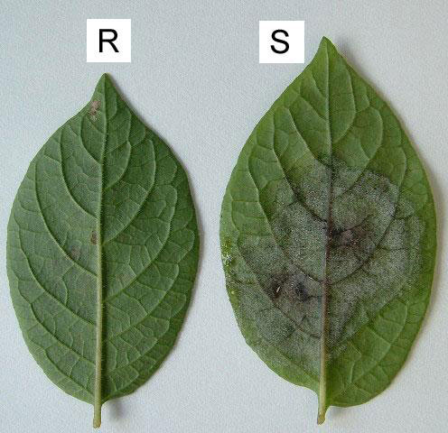
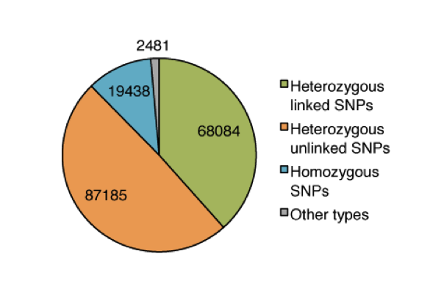
Linked SNPs in wild potato resistant to Phytophthora infestans
Bubbleparse finds trait-linked SNPs
F1 Manually scored for resistance
Sequenced normalised bulk cDNA of 30 R and 30 S
SNPs linked to resistance expected to be 50/50 Het
Solanum berthaultii (R) x Solanum stenotomum (S)
Walter Verweij
Jonathan Jones
Het Linked SNP | Het Unlinked SNP | Total
14/15 | 8/10 | 22/25
Richard Leggett et al PLoS ONE 8(3): e60058. doi:10.1371/journal.pone.0060058
Notes:
And we’ve successfully applied the system to find thousands of candidate SNPs that may be linked to resistance to late blight resistance in unsequenced wild potato species.
Here we crossed resistant and susceptible potato and sequenced bulks of the offspring – expecting SNPs with allele frequency of 50% - then identified these with Bubbleparse, generating thousands of candidate SNPs in small contigs that could be used in BLAST or other functional searches to find potential variants in Rgenes or other important sequences.

Slide 27
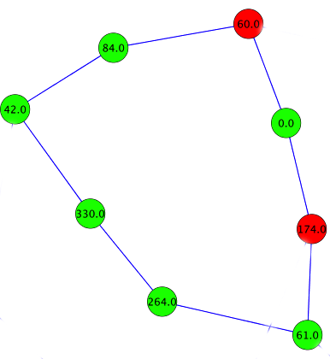
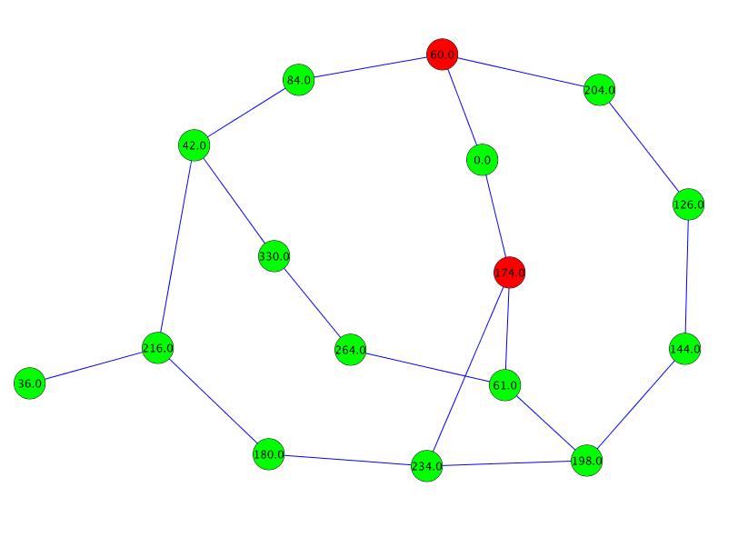
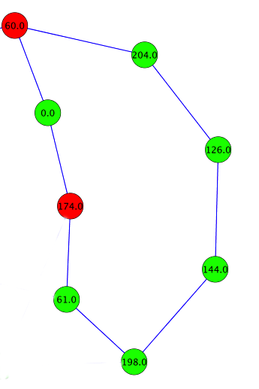
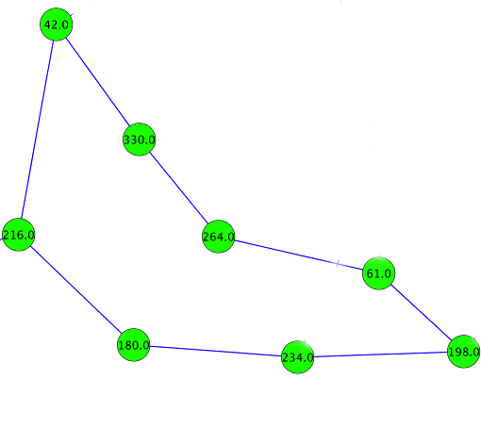
Untangling bubbles with 2k+2
Younsi and MacLean Bioinformatics doi: 10.1093/bioinformatics/btu706
Notes:
In the midst of this we found that the bubbleparse system didn’t find SNPs in regions where the assembly got complicated, like in repeats. The knot on the left is a typical structure in the internal representation of genome assemblies and Bubbleparse just got lost here. The ideal result would be to break those knots into their component parts. So we implemented a system, called 2k+2 that separates these out by carefully walking and enumerating particularly sized and characterised graph structures..

Slide 28
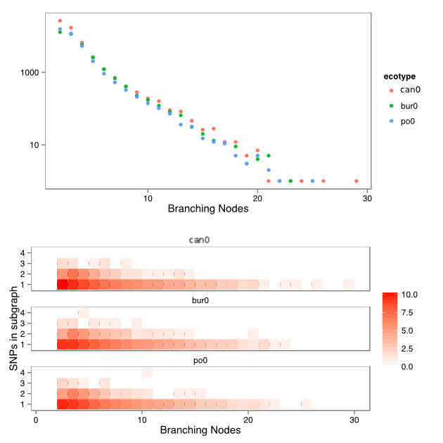
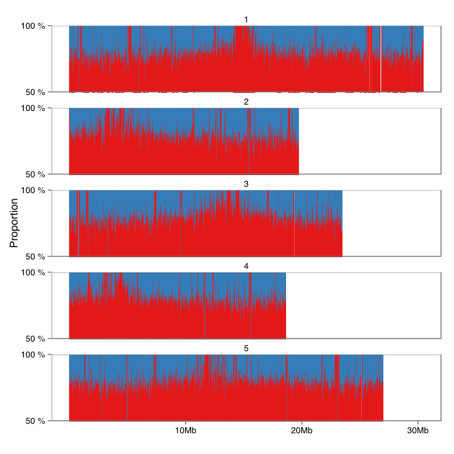
2k+2 sensitive complex bubble detection
TSU1 vs Col0, reads from Schneeberger et al 2011 (1001 genomes)
Blue = 1001 Genomes
Red = 2k+2
Younsi and MacLean Bioinformatics doi: 10.1093/bioinformatics/btu706
Notes:
We ran this algorithm on a range of Arabidopsis ecotypes and looked at the complex regions, those parts of the graph with many branching nodes in. 2k+2 found many SNPs in this regions that were also highly accurate SNPs (mean of 85%) across the whole genome.
Together these programs provide a powerful platform to find SNPs in situations where you lack a reference genome.

Slide 29
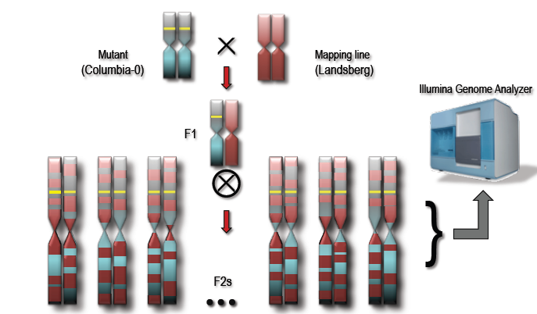
Profiled SNP frequency peaks around mutation after crosses
Notes:
Another approach we’ve been taking is to identify the actual causative mutation directly from the sequence or assembly. And to do this we take advantage of the fact that in forward genetic screens, when a mutagenesis is carried out and crosses are done later, we see that the SNP frequency around the mutation we are selecting for fades out as we get further across the chromosome. We can use this pattern to our advantage

Slide 30
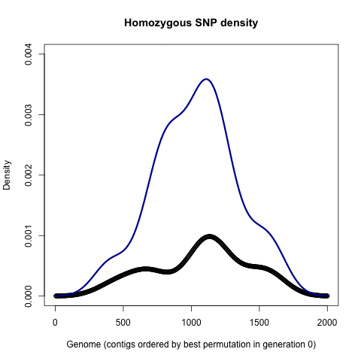
GATROC - optimising contig order
Unordered contigs
Ordered contigs
Pilar Corredor-Moreno and Ed Chalstrey
Notes:
When we have a draft assembly of contigs or just reads, then the random order means that the distribution is smoothed out. We can put the peak back by reordering the contigs properly and we’ve been doing this with genetic algorithms that explore permutations and select the most appropriate. This picture shows a version looking for the optimum blue line and improving the permutations at each iteration.
Together the SNP finding and causative mutation finding software are a great package for working with important and possibly disease resistance causing variation in species without taking a traditional genomics path.

Slide 31
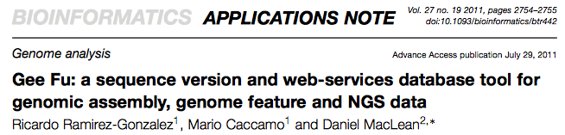
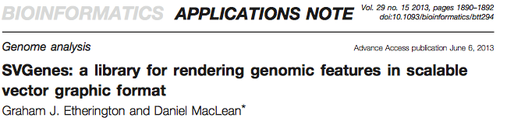

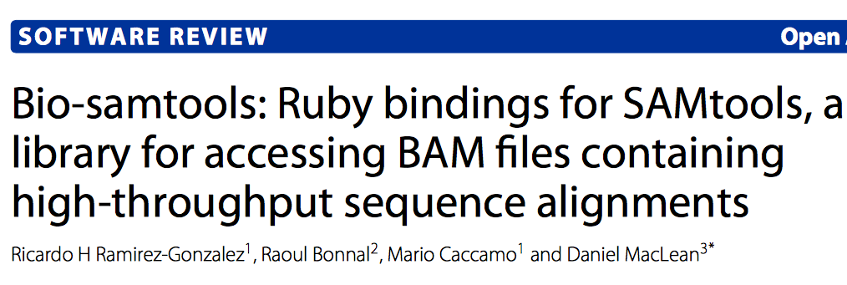
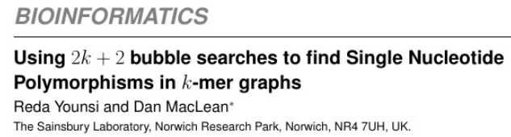
HIGHLY USED SOFTWARE
over 35,000 downloads
Notes:
AS bioinformaticians we like to think we’re craftsmen as well,. Its important to us to make high-quality open-source software, we regularly package our internal tools for the bioinformatics user and these have had a significant reception, receiving over 35000 downloads in total to date.

Slide 32
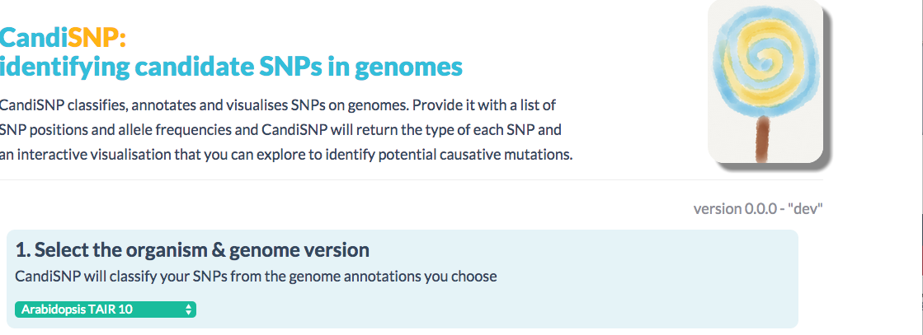
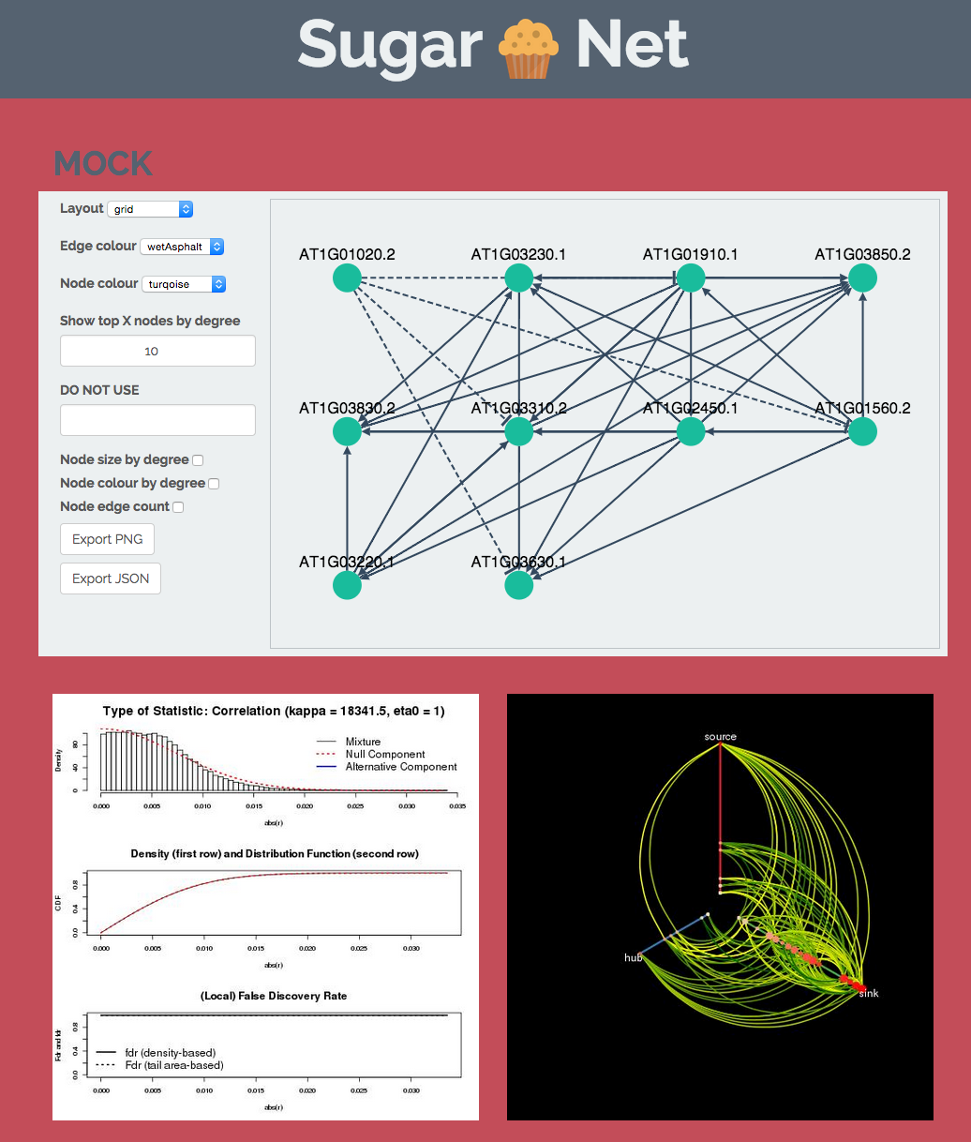
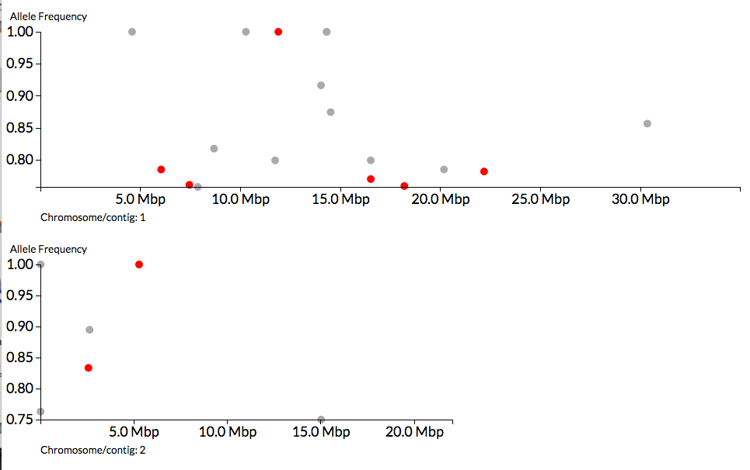
Sweetening bioinformatics
Etherington, Monaghan et al 2014
Notes:
And this philosophy extends to tools we produce for our bench based colleagues. These two examples, CandiSNP and SugarNet are tools for identifying causative mutations WITH a reference genome and predicting gene regulatory networks from expression data respectively – two quite involved bioinformatics pipelines turned into accessible tools.

Slide 33
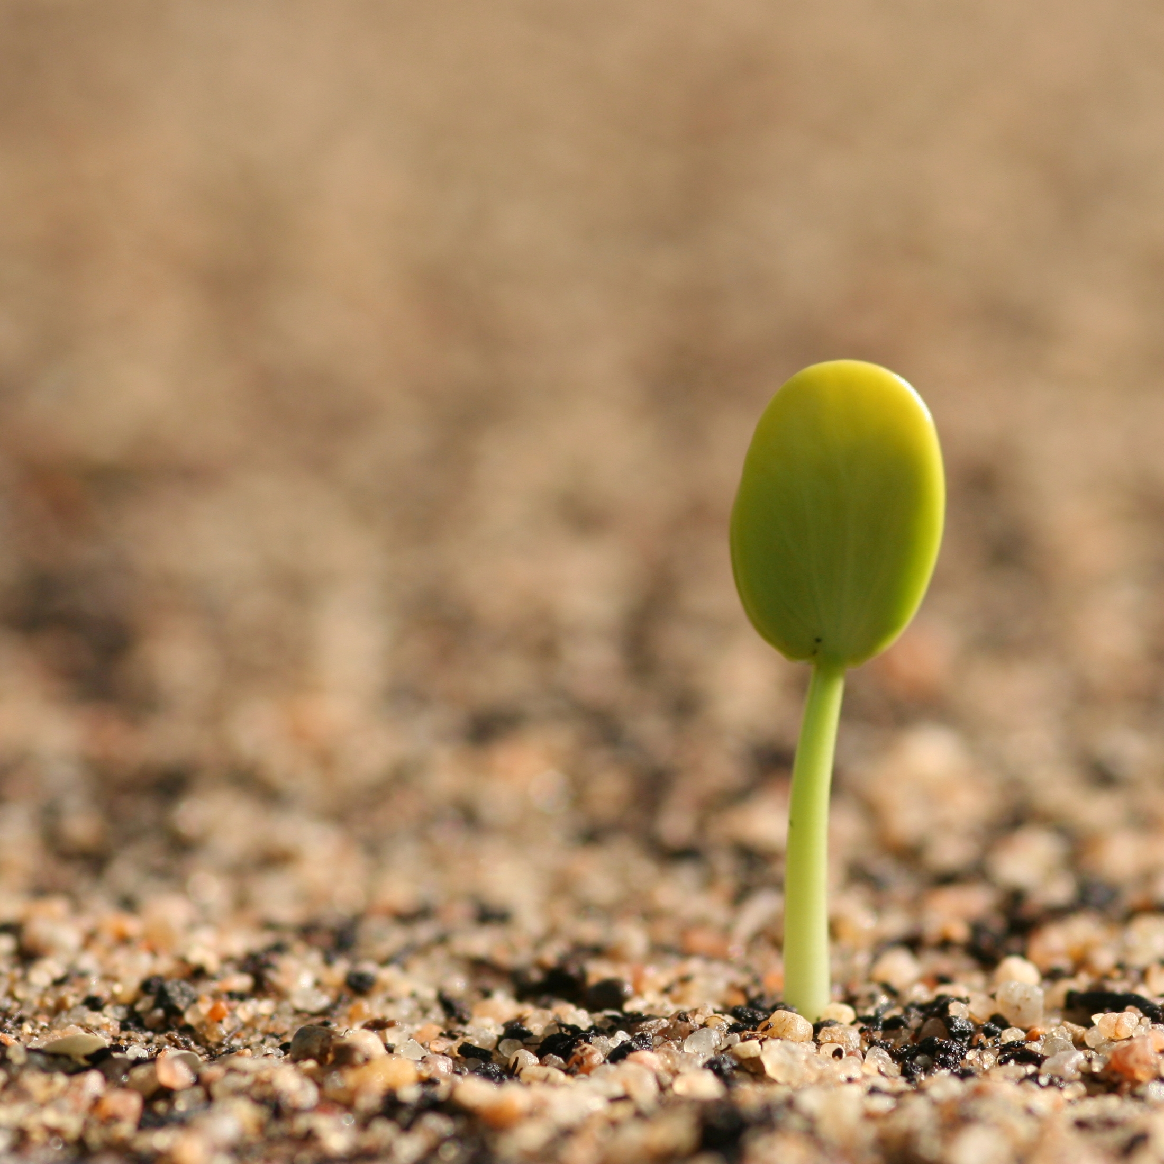
From small beginnings…
Genomics projects can be grown
Notes:
So, those are the projects we’ve got going on in my group that I wanted to tell you about. We’ve seen that we don’t need to feel restricted by the way we play science to get projects launched, we can make much better use of the people and expertise around us. We’ve also shown that with a bit of smart thinking we can get around the canonical ways of doing genomics.
Together these attitudes and approaches are going to help us germinate and grow our work even better.

Slide 34






Acknowledgements
Martin Page
Shyam Rallapalli
Pilar Corredor-Moreno
Carlos Lugo
Christian Schudoma
Graham Etherington
Ed Chalstrey
Reda Younsi
Thomas Down
Sophien Kamoun
Kentaro Yoshida
Diane Saunders
Suomeng Dong
Joe Win
Cyril Zipfel
Jacqueline Monaghan
Rosa Lozano-Duran
Allan Downie
Anne Edwards
Mario Caccamo
Bernado Clavijo
David Swarbreck
Manuel Corpas
Ricardo Ramirez-Gonzalez
Richard Leggett
Notes:
So finally here are just a few acknowledgements, not everyone we’ve worked with at TSL
This is a list of people involved with the work I concentrated on in this talk.

Slide 35

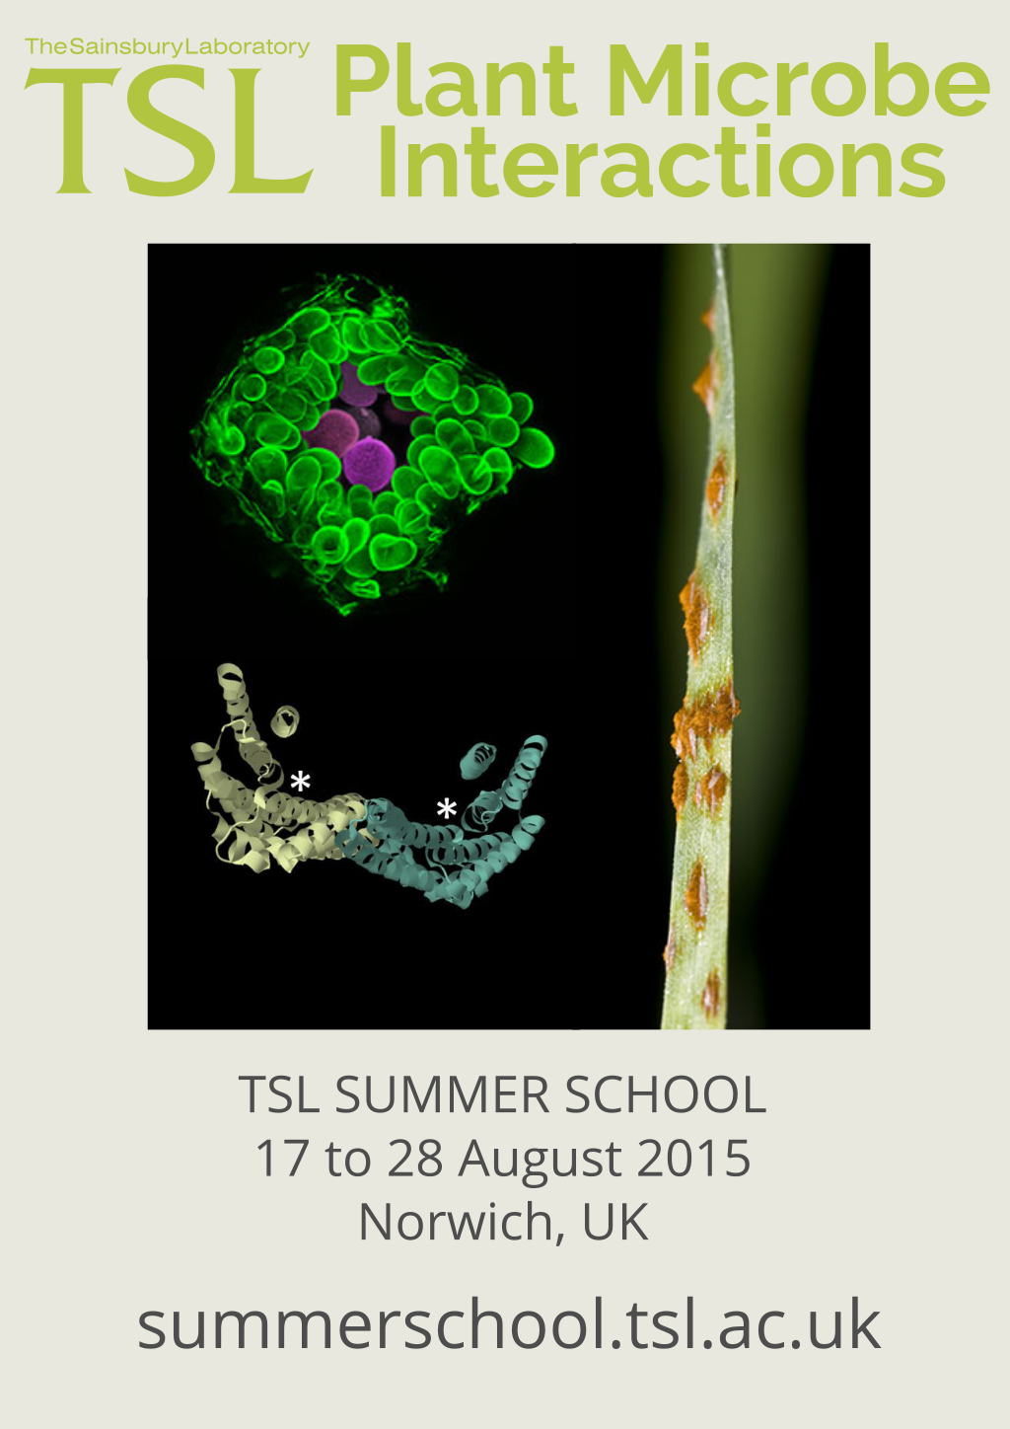
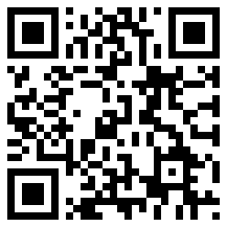
http://tinyurl.com/dan-maclean

Slide 36

How do you bridge the gap between biologist and bioinformatician?

Slide 37
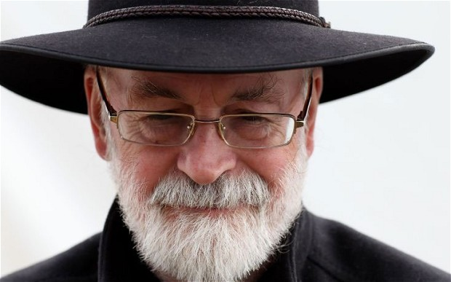
If you build a man a fire, you'll keep him warm for a night. If you set a man on fire, you'll keep him warm for the rest of his life.
— Terry Pratchett
author of Discworld novels
Notes:
So to steal from Terry Pratchett…

Slide 38
ADVERTISEMENT
Notes:
We like galaxy so much, we’ve got really involved. I co-ordinate the UK Galaxy Community and we’re hosting the Galaxy Community Conference at TSL next year. If you are interested in Galaxy either as a biologist who wants to learn it or an informatician who wants to run it this is the best conference.
Around 250 people attend and the first part is all training, the first days are dedicated to workshops run by the galaxy developers themselves.
So please consider yourselves, formerly invited.

Slide 39
Multidisciplinary approaches
Notes:
There are other things going on in my group, not least we’ve been working on reaching wider, non-specialist groups.

